Slide 1
Chapter 13
Creating a Workbook

Slide 2
Learning Objectives
Understand spreadsheets and Excel
Enter data in cells
Edit cell content
Work with columns and rows
Work with cells and ranges
Work with formulas and functions
Preview and print a workbook

Slide 3
Understanding Spreadsheets and Excel
Topics Covered:
  Parts of the Excel Window
  Moving the Active Cell
  Switching Between Sheets
  Inserting and Deleting a Sheet
  Renaming a Sheet
  Moving and Copying a Sheet

Slide 4
The Excel Window
Excel stores spreadsheets in files called workbooks.
Each workbook is made up of individual sheets.
Each sheet is identified by a sheet name
The sheet name is displayed in its sheet tab at the bottom of the Excel application window
. Excel supports two kinds of sheets:
  Worksheets - contains data, laid out in a grid of rows and columns
  Chart sheets- contains a visual representation of spreadsheet data.

Slide 5
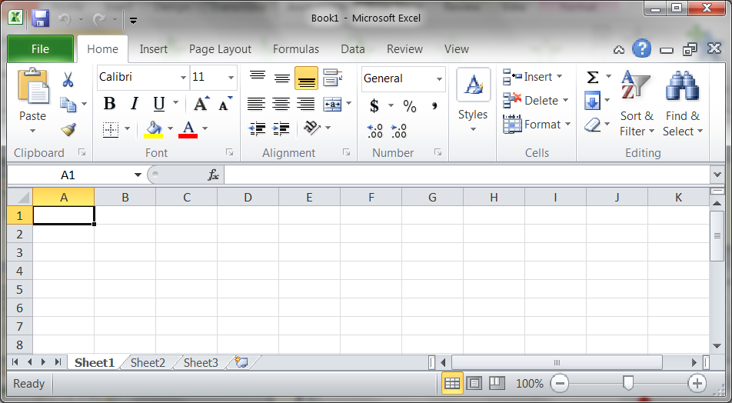
Parts of the Excel window
Cell Reference
Formula Bar
Active Cell
Column Heading
Row Heading

Slide 6
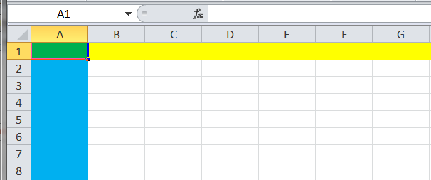
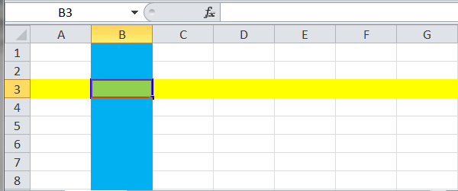
Parts of the Excel window
Rows and columns intersect in a single cell; all the data entered in a worksheet is placed in cells.
Each cell is identified by a cell reference, which indicates its column and row location.
The cell in which you are currently working is the active cell.

Slide 7
Moving (selecting) the Active Cell
There are a number of ways that you can move (select) the active cell, they include;
  Point at the cell and click on it.
  Tab Key to move one cell left
  Shift + Tab keys to move one cell right
  Arrow keys to move up, down, right, left
  Enter key to move down one cell.
  Shift + Enter to move one cell up.
  See Exhibit 13 – 3 on page 427 for other options.

Slide 8
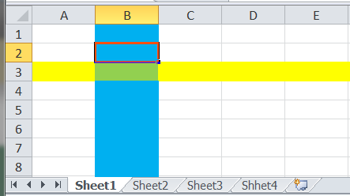
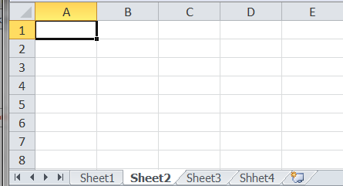
Switching Between Sheets
The sheet currently displayed in the workbook window is the active sheet, and its sheet tab is white.
You can easily move from one sheet to another, by clicking on the sheet..

Slide 9

Inserting and Deleting a Sheet
Although each workbook includes three worksheets to start, sometimes you will need more or fewer worksheets.
To add worksheets click on the Insert Worksheet Tag.
To delete a worksheet right click on the worksheet and from the menu that appears select Delete

Slide 10
Renaming a Sheet
You can rename sheets with more meaningful names so that you know what they contain.
To rename a sheet double click on the sheet name and type a new name.

Slide 11
Moving and Copying a Sheet
You can change the placement of the sheets in a workbook.
Select the sheet and drag it.
As you move by other sheets a small black triangle appears at the left edge of the of each sheet indicating the selected sheet will be positions after that sheet.

Slide 12
Entering Data in Cells
You enter data by typing it into the active cell.
The formula bar displays the contents of the active cell, which can be data or, as you’ll see later, the underlying formulas used to create a calculated value.
Topics Covered:
  Entering Text
  Entering Dates and Times
  Entering Numbers

Slide 13
Entering Text and Numbers
Text data is a combination of letters, numbers, and symbols that form words and sentences.
Text data is often referred to as a text string because it contains a string of text characters.
Number data is any numerical value that can be used in a mathematical calculation.
If an integer is longer than its cell size, you see ###### in the cell instead of its value.
Decimal values are rounded to fit the cell.

Slide 14
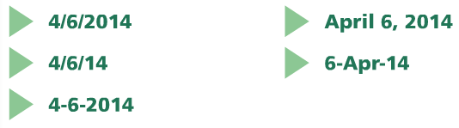
Entering Dates and Times
Date data and time data are commonly recognized formats for date and time values.
Dates can be entered in any of the standard formats
Dates are actually numbers that are formatted to appear as text
This allows you to perform calculations with dates, such as determining the elapsed time between two dates.

Slide 15
Editing Cell Content
You could simply make the cell active and type the new entry, or you could clear the value in the cell and then type the correct value.
However, sometimes you need to edit only a portion of an entry rather than change the entire contents of a cell
To directly edit cell contents:
  Double-click the cell, or
  Select the cell, click anywhere in the formula bar, and then click in the cell, or
  Select the cell, and then press the F2 key
Doing any of the above will activate the formula bar and all you to edit part of the cell contents.

Slide 16
Working with Columns and Rows
You can modify a worksheet to make it easier to read and include more data. To do this, you will need to
  Selecting Columns and Rows
  Changing Column Widths and Row Heights
  Inserting a Column or Row
  Clearing and Deleting a Row or Column

Slide 17
Selecting Columns and Rows
To select an entire column, you click its column heading.
To select an entire row, you click its row heading.
You can drag across multiple column headings or row headings to select adjacent columns or rows.
To select nonadjacent columns or rows, you press the Ctrl key as you click column or row headings.
You can select all the columns and rows in a worksheet by clicking the Select All button in the upper-left corner of the worksheet.

Slide 18
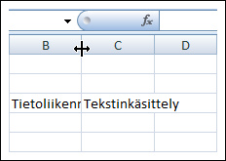

Changing Column Widths and Row Heights
The default sizes of the columns and rows in a worksheet might not always accommodate the information you need to enter
Excel displays only as much text as fits into the cell, cutting off, or truncating, the rest of the text entry.
If the default column width is too narrow, you can widen it by dragging the column border.
  Move the pointer over the right border until you see the double headed arrow.
When you drag the column border, a ScreenTip appears identifying the width of the column in characters, followed in parentheses by the width of the column in pixels.

Slide 19
Changing Column Widths and Row Heights
AutoFitting eliminates any empty space by matching the column to the width of its longest cell entry.
The simplest way to AutoFit a column is
  Move the pointer over the right border until you see the double headed arrow.
  Double click when you see the double headed arrow appear.

Slide 20
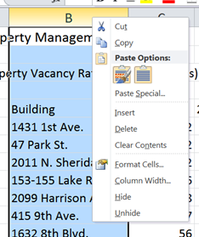
Inserting a Column or Row
When you insert a new column, the existing columns shift to the right and the new column has the same width as the column directly to its left.
When you insert a new row, the existing rows shift down and the new row has the same height as the row above it.
To insert a new row or column;
  Select the row or column
  Right click on the row or column
  From the list that appears select Insert.

Slide 21
Clearing and Deleting a Row or Column
You can remove data in two ways:
  Clearing—Removes data from a worksheet but leaves the blank cells
  Deleting—Removes both the data and the cells from the worksheet
Pressing the Del key removes the contents from the cell but does not remove the cell from the worksheet

Slide 22
Clearing and Deleting a Row or Column
When you delete a column, the columns to the right shift left to fill the vacated space.
Similarly, the rows below a deleted row shift up to fill the vacated space.
Deleting a column or row has the opposite effect from inserting a column or row.
To delete a new row or column;
  Select the row or column
  Right click on the row or column
  From the list that appears select Insert

Slide 23
Working with Cells and Ranges
Topics Covered:
  Selecting a Range
  Moving and Copying a Range
  Inserting and Deleting a Range
  Wrapping Text Within a Cell

Slide 24
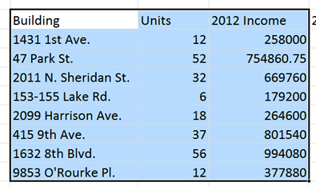
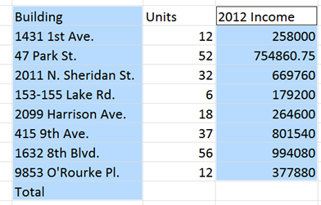
Working with Cells and Ranges
A group of cells is called a cell range or range.
Ranges can be either adjacent or nonadjacent.
An adjacent range is a single rectangular block of cells.
A nonadjacent range consists of two or more distinct adjacent ranges.

Slide 25
Selecting a Range
You select adjacent and nonadjacent ranges of cells with the pointer, just as you selected individual cells.
To select adjacent cell ranges
  Select the first cell in the range
  Hold down the left mouse button
  Drag the pointer to the last cell in the range
To select adjacent cell ranges
  Select the first cell in the first range
  Hold down the left mouse button
  Drag the pointer to the last cell in the first range
  Click on the Ctrl Key and repeat the above procedure for the other nonadjacent ranges.

Slide 26
Moving and Copying a Range
Methods for moving and copying a range:
  Drag and drop
  Some people find drag and drop a difficult and awkward way to move or copy a selection, particularly if the worksheet is large and complex. In those situations, it is often more efficient to cut and paste the cell contents or to copy and paste them.
  Cut and paste (to move)
  Copy and Paste (to copy)
  When you cut or copy a range, the selected cells are surrounded by a blinking border, indicating that the selection is stored on the Clipboard. The blinking border remains until you paste the range or start entering data in another cell.

Slide 27
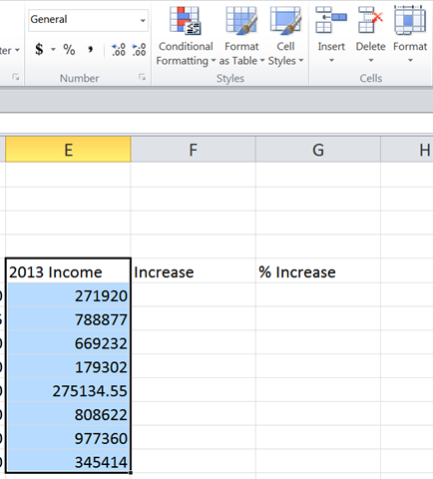
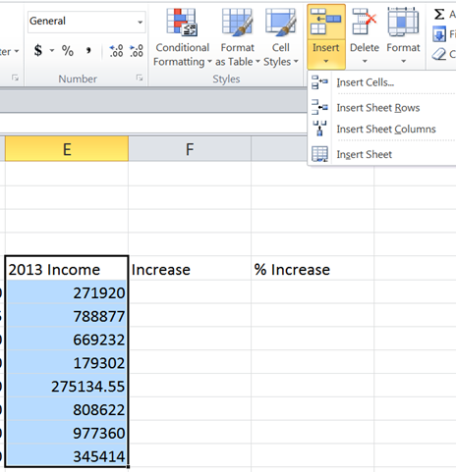
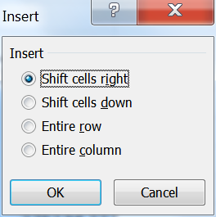
Inserting and Deleting a Range
Another use of selecting a range is to insert or delete cells within the worksheet.
To insert or delete a range of cells do the following
  Select the range of cells.
  In Cell menu click on the arrow below Insert or delete
  From the list that appears select Insert cells
  The following dialog box appears
  Select the option you want to perform

Slide 28
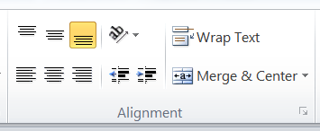

Wrapping Text Within a Cell
You can force text that extends beyond a cell’s border to fit within the cell.
You do this by
  Selecting the cell in which the text to be wrapped appears
  Click the Wrap Text button in the Alignment group on the Home tab
The text will wrap on as may lines as it takes depending on the cell width.

Slide 29
Entering Formulas and Functions
Topics Covered:
  Entering a Formula
  Viewing Formula Results and Formulas
  Copying and Pasting Formulas
  Entering a Function
  Using AutoSum

Slide 30
Entering a Formula
A formula is a mathematical expression that returns a value.
Every Excel formula begins with an equal sign (=) followed by an expression that describes the operation to be done.
A formula is written using operators that combine different values, returning a single value that is then displayed in the cell. Operators include
  Addition +
  Subtraction -
  Multiplication *
  Division /
  Exponentiation ^

Slide 31
Order of Precedence
The order of precedence is a set of predefined rules to determine the sequence in which operators are applied in a calculation:
  First Exponentiation (^)
  Second Multiplication (*) and division (/)
  Third Addition (+) and subtraction (-)
To change the order of operations, you can enclose parts of the formula within parentheses. Any expression within a set of parentheses is calculated before the rest of the formula.

Slide 32
Order of Precedence
Examples of order of precedence
  = 3+4*5
    result 23
    the 4 is multiplied by the 5 first equaling 20 then the 3 is added
  = (3+4)*5
    result 35
    the 3 is added to the 4 first equaling 7 and then multiplied by the 5
  50/10*5
    result 25
    50 is divided by 10 first equaling 5 and then multiplied by 5
  50/(10*5)
    result 1
    5 is multiplied by 10 first equaling 50 and then divided into 50

Slide 33
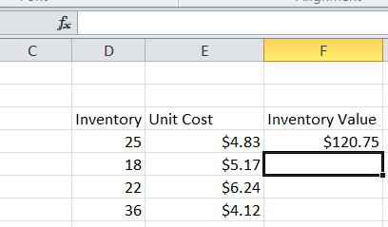
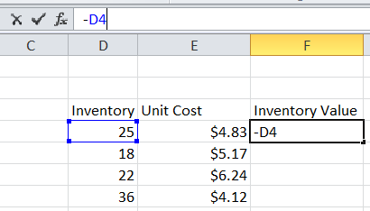
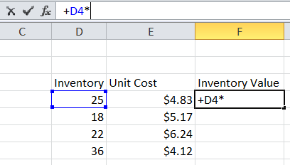
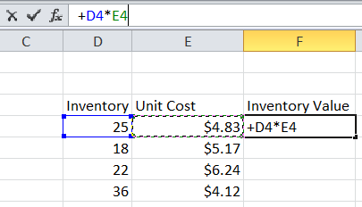
Entering a Formula
In many cases we are not entering numbers but working with cells
Start the process by entering the equals sign in the formula bar
Enter the first cell reference by either typing it in or clicking on the cell.
Next enter the operator.
Enter the second cell reference by either typing it in or clicking on the cell.
Hit the Enter Key

Slide 34
Viewing Formula Results and Formulas
After a formula has been entered into a cell, the cell displays the results of the formula and not the formula itself.
You can view the formula by selecting the cell and reviewing the expression in the formula bar.
You can also double-check that the formula references the correct cell by looking at which cells are color coded.

Slide 35
Creating Effective Formulas
Creating Effective Formulas
  Keep formulas simple. Use functions (explained in the nest section) in place of long, complex formulas whenever possible.
  Do not place important data in formulas. Instead place them in a separate cell. An example would be a tax rate.
  Break up formulas to show intermediate results. Complex calculations should be split so that the different parts of the computation are easily distinguished and understood. Use separate cells to breakup complex functions.

Slide 36

Copying and Pasting Formulas
Sometimes, you’ll need to repeat the same formula for several rows of data. Rather than retyping the formula, you can copy the formula, and then paste it into the remaining rows.
There two ways to copy and paste formulas
  You can select the cell and perform the copy command and then select the cell where the formula is to go and perform the paste command
  Or if the cells where the formula is to be placed are adjacent to the cell with the formula you can use the copy handle found at the bottom of the cell.
  You move your mouse over the handle and drag it to the adjacent cells.

Slide 37
Entering a Function
A function is a named operation that returns a value.
Functions are used to simplify formulas, reducing what might be a long expression into a compact statement.
An example
To add the values in the range A1:A9, you could enter the long formula:
  =A1 +A2+A3+A4+A5+A6+A7+A8+A9
Or, you could use the SUM function to accomplish the same thing using the function
  =SUM(A1:A9)

Slide 38
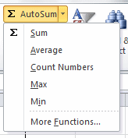
Entering a Function
Excel supports over 300 different functions from the fields of finance, business, science, and engineering.
Excel provides some basic functions using the AutoSum down arrow on the Home tab.

Slide 39
Entering a Function
The individual AutoSum functions are;
  SUM - Sum of the values in the column or row
  AVERAGE- Average value in the column or row
  COUNT - Total count of numeric values in the column or row
  MIN - Minimum value in the column or row
  MAX - Maximum value in the column or row

Slide 40
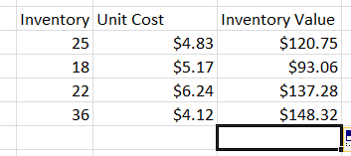
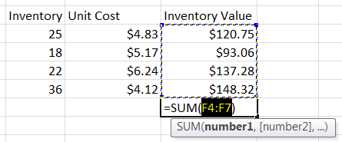
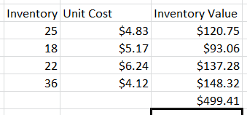
Using AutoSum
AutoSum inserts one of five common functions and a range reference that Excel determines by examining the layout of the data and choosing the most likely range.
To use AutoSum
  Select the sell you want the sum to appear in.
  Click on the AutoSum button in the Editing panel of the Home tag, the cell will display what is being summed
  Click the enter key,.

Slide 41
Previewing and Printing a Workbook
Topics Covered:
  Changing Worksheet Views
  Changing the Orientation
  Previewing and Printing a Workbook
  Viewing Worksheet Formulas
  Scaling a Printout

Slide 42
Changing Worksheet Views
You can view a worksheet in three ways:
  Normal View: shows the contents of the current slide
  Page Layout View: shows how the current sheet will look when printed
  Page Break View: displays the location of page breaks within the worksheet

Slide 43
Changing the Orientation and Printing
You can adjust the worksheet so that it prints on a single page by changing the page orientation to landscape.
You can print the contents of a workbook by using the Print tab in Backstage view.

Slide 44
Viewing Worksheet Formulas
You can view the formulas in a workbook by switching to formula view, which displays the formulas used in a worksheet instead of the resulting values.
You can scale the worksheet to force the contents to fit on a single page.

